Slide 1
CHOPIN Project
Meeting
9 April, 2013
http://chopin.isr.uc.pt
Notes:
Use Case: Imagine I give you the task to clean the table. So things that influences your brhavious for this task are:
1. can you move(mobile or not)
2. Do you have hands or your just made of sensors and no actuators.So may be you can just help locating the mess.
3. DO you have battery left to do the job.
4. What is there on the table. DO you have to remove stuffs or just wipe the surface clean

Slide 2
4. Next meetings
WP2 – T2.1 Implementation of context recognition methods in mobile robots
Scope
Improving situation awareness by humans in cooperative scenarios with human teams and robotic teams
Situation awareness is related with context awareness
Endow mobile robots with collaborative context awareness
Context can find different concretizations depending of information domain
Create a vocabulary for context recognition methods to be applied
<number>
CHOPIN R&D project

Slide 3
WP2 – T2.1 Implementation of context recognition methods in mobile robots
Objectives
Identify context at agent level, cooperation level and global level.
For each level we must enumerate information about environment, mission and self-characteristics.
For each task we want to operationalize this information must be elicitated at the different levels.
Conclusion: Iterative process with 3 phases for each iteration
Each iteration corresponds to a full analysis for one task
<number>
CHOPIN R&D project

Slide 4
WP2 – T2.1 Implementation of context recognition methods in mobile robots
Methodology
Information elicitation
Table representation
Ontology model
<number>
CHOPIN R&D project

Slide 5
WP2 – T2.1 Implementation of context recognition methods in mobile robots
Information elicitation (from BSC meeting)
Location
Fire class
Infrastructure characteristics (e.g. Types of inflamable materials in the building)
On-site (outside) visual information (e.g. Smoke sources, infrastructure characteristics)
On-site (inside) environmental conditions (e.g. Temperature, smoke concentration, sounds)
Building utilization schedules (e.g. Working schedule)
Building topological points-of-interest (e.g. Entrances/exits locations and dimensions, water access points, static obstacles, potential explosion points)
<number>
CHOPIN R&D project

Slide 6
WP2 – T2.1 Implementation of context recognition methods in mobile robots
Information elicitation (from tasks)
Context will be defined as the set of information which influence the performance of an agent while attempting to execute a desired behavior (e.g. task). This means that any set of information will be only considered to be context if it anticipate how the agent should behave when that information is present.
Making a long story short… For each behavior/task we want to achieve we must answer “What influences the agent to do what it is asked for?”
It is expected we can summarize a list of “influences” for each project group. For example, if we want to deploy a MANET, what are the features that influence the agent behavior?
The agent must know:
its battery status;
if it is in range of at least one neighbor;
what topology is desired for the network;
what is its role in the group;
the connectivity level of the network;
mission status;
environment conditions nearby and if possible at the goal point.
…
<number>
CHOPIN R&D project

Slide 7
WP2 – T2.1 Implementation of context recognition methods in mobile robots
Table representation (scenario information)
Scenario (Environment) | Use Case (Mission) | Task (Behaviour) | Requirement | Equipment (Self-Characteristics)
sc1 Fire in large basement garage | uc1.1 Cooperative mapping and exploration through smoke | t1.1.1 deploing a MANET | range sensors not disturbed by smoke multi-hop peer-to-peer and multicast ad hoc wireless communication through MANET cooperative SLAM, navigation and exploration algorithms cooperative mapping of relevant environmental variables (sensors for gases concentration, temperature) detection of human bodies based on thermal and vocal information audio and light beacons to attract attention input/output audio devices and light for telepresence near the victim pull bar where victims can grab while being guided in evacuation procedure | ground mobile robots (differential robot, car-like robot) range sensing through smoke (sonars, ultrawide band radar) wireless communication (wifi, zigbee, bluetooth) SLAM, navigation, exploration algorithms (EKF, particle filter, visual SLAM) measurement of dangerous gases concentration (miscellaneous transducers) detection of human bodies (infrared camera, thermopile) detection of sound direction (microphone array) signalizing the presence of the robot (yellow light, speaker, beeper) remote image of poor illuminated sites (cameras, light) audio communication (microphone, speaker) guiding victims in evacuation procedure (pull bar)
<number>
CHOPIN R&D project

Slide 8
t1.1.2 exploring the environment
t1.1.3 building a map for navigation
t1.1.4 detecting and localizing fire outbreaks
t1.1.5 detecting and localizing victims
uc1.2 Assessment of victim health condition and telepresence | t1.2.1 signalizing location
t1.2.2 monitor fire evolution in the surroundings and transmit information to the command center

Slide 9
WP2 – T2.1 Implementation of context recognition methods in mobile robots
Table representation (classified information)
Actors | Event Class | Infrastructure characteristics | Context description
Type | Sensors | Interaction | Communication | Algorithms | Status | Area / Location | Points-of-interest | Schedules | Inflamable Materials (in-side building) | Environment (out-side) | Environment (in-side)
robots (ground - differential, car-like) , persons (firefighters, victims) | range sensing through smoke measurment of dangerous gases concentration detection of human bodies (ir camera, thermopile) detection of sound (microphone array) | ligths speaker beeper | wireless communication (wifi, zigbee, bluetooth, rf) | SLAM Navigation Exploration SAR Protocols (Reconnaincanse,...) | robots (location, mission, broken, lost, endangered) firefigthers (location, mission, endangered, lost, dead) victims (location, dead, lost, endangered) | Fire A, Fire B, Fire C, Fire D | basement garage, mall, latitude, longitude | Water access points Potential explosion points | Occupancy time slots | strutural information of the building | entrances / exits smoke sources | Static obstacles (Stais, Elevators, Walls) | .sensors (input): ? .mission: ? .behaviour (output):?
.sensors (input): ? .mission: ? .behaviour (output):?
.sensors (input): ? .mission: ? .behaviour (output):?
temperature humidity gases concentration smoke | .sensors (input): ? .mission: ? .behaviour (output):?
infrared camera thermopile location map | .sensors (input): ? .mission: ? .behaviour (output):?
beep light | .sensors (input): ? .mission: ? .behaviour (output):?
map information from nearby agents temperature humidity gases concentration | .sensors (input): ? .mission: ? .behaviour (output): establish contact bridge between the victim and remote human rescuers through audio feedback
<number>
CHOPIN R&D project

Slide 10
WP2 – T2.1 Implementation of context recognition methods in mobile robots
Taxonomy model (v1.1)
Contextual Information
Mission related
Agent related
Environment related
Victim mapping
Fire mapping
Abnormal situation
MANET connectivity
Agent connectivity
Mobility
Pose
Robot related
Firefighter related
Scenario mapping
Smoke mapping
Abnormal situation
Gas leak
Victim status
Battery status
Abnormal situation
Breathing apparatus status
Abnormal situation
Collapse of scenario
Breakdown
Unconscious
Injured
Classes / types of contexts
Contexts at the macroscopic collective level
Contexts at the microscopic agent level
<number>
CHOPIN R&D project

Slide 11
WP2 – T2.1 Implementation of context recognition methods in mobile robots
Ontology model (to do)
Tool: Protégé (open source ontology editor, it supports class and property definitions and relationships, property restrictions, instance generation, and queries)
Language: OWL (is an extension to XML and RDF (Resource Description Framework) schema that defines terms commonly used in creating a model of an object or process. OWL is a World Wide Wide Consortium (W3C) recommendation, which is analogous to an international standard in other standards bodies)
<number>
CHOPIN R&D project

Slide 12
WP2 – T2.1 Implementation of context recognition methods in mobile robots
Example (t111 – deploing a MANET)
We discussed the approach of vertically developing each task. This approach will aim to deliver tasks as behaviors that an agent can perform. After a task is fully developed we can progress to the next one. This will ensure that at least a minimum set of behaviors will be fully developed.
Task 1.1.1 “deploiment of a MANET”, was identified as a good starting point for exploring this approach, thus requiring the elicitation of context.
The impact of context-awareness while performing this task will help to understand and decide situations when an agent may be static for a long period, which is normally associated with a malfunction but if the agent has mobility restrictions imposed by low network signal, its role in the MANET, mission status, nearby perils. The relevant information (e.g. Context) can be redirected to the CCO and help decide correctly the next step with a great degree of confidence.
<number>
CHOPIN R&D project

Slide 13
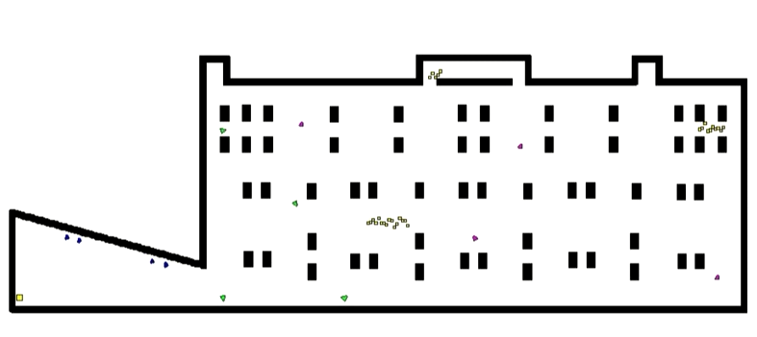
EXAMPLE 1
Contextual Information
Mission related
Agent related
Environment related
Victim mapping
Fire mapping
Abnormal situation
MANET connectivity
Agent connectivity
Mobility
Pose
Robot related
Firefighter related
Scenario mapping
Smoke mapping
Abnormal situation
Robots exploring
the scenario
Gas leak
Victim status
Battery status
Abnormal situation
Breathing apparatus status
Abnormal situation
Collapse of scenario
Breakdown
Unconscious
Injured
Mission: Exploration of the scenario
Agent: Robot
For example, a robot must have as its mission to explore the scenario. However, if it is one that bridges the connection between the CC and the other members of the team (the context of local connectivity) and the network has no redundancy other nodes to relay messages (Connectivity context of MANET) then the robot will abdicate its mission to focus on keeping the network connects.
Local connectivity
network
Connectivity to CC

Slide 14
EXAMPLE 2
Contextual Information
Mission related
Agent related
Environment related
Victim mapping
Fire mapping
Abnormal situation
MANET connectivity
Agent connectivity
Mobility
Pose
Robot related
Firefighter related
Scenario mapping
Smoke mapping
Abnormal situation
Gas leak
Victim status
Battery status
Abnormal situation
Breathing apparatus status
Abnormal situation
Collapse of scenario
Robot breaks connectivity to signalize victim
Breakdown
Unconscious
Injured
Local connectivity
network
Mission: Detecting Victims in the scenario
Agent: Robot
For example, when a robots finds a victim in the scenario, it may temporarily break the MANET connectivity to signalize the victim’s existence and assess its status

Slide 15
EXAMPLE 3
Contextual Information
Mission related
Agent related
Environment related
Victim mapping
Fire mapping
Abnormal situation
MANET connectivity
Agent connectivity
Mobility
Pose
Robot related
Firefighter related
Scenario mapping
Smoke mapping
Abnormal situation
Gas leak
Victim status
Battery status
Abnormal situation
Breathing apparatus status
Abnormal situation
Collapse of scenario
Robot detects a high gas concentration and informs nearest firemen team
Breakdown
Unconscious
Injured
Local connectivity
network
Mission: Detecting Fire outbreaks
Agent: Robot & Fireman
For example, when a robot detects high gas concentration, it may inform the nearest fireman of a possible fire outbreak.

Slide 16
WP2 – T2.1 Implementation of context recognition methods in mobile robots
References
Turner, R., “Context-mediated behavior for intelligent agents”, Int. J. Human-Computer Studies (1998) 48, 307-330, 1998.
Schlenoff, C., Messina, E., “A Robot Ontology for Urban Search and Rescue”, Proceedings of the 2005 CIKM Conference: Workshop on Research in Knowledge Representation for Autonomous Systems, 2005.
Weihong, Y., “Research on Maritime Search and Rescue Decision-making Ontology Model”, 2009 International Conference on Environmental Science and Information Application Technology, 2009.
Randelli, G., Iocchi, L., Nardi, D., “User-friendly security robots”, Proceedings of the 2011 IEEE International Symposium on Safety,Security and Rescue Robotics, 2011.
<number>
CHOPIN R&D project

Slide 17
MANET: Context (José Santos)
Link Quality
Impact on Agent mobility
(agent might need to reevaluate priorities)
Group Connectivity (Fiedler Value)
Metric for graph connectivity
(collaboration and group cohesion)
<number>
CHOPIN R&D project

Slide 18

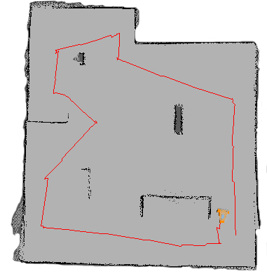
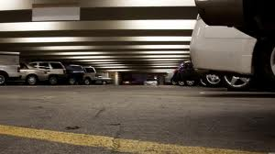
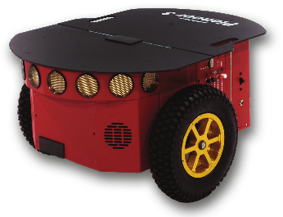
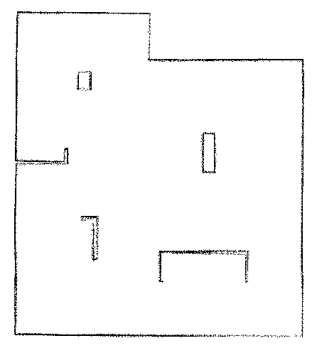
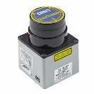
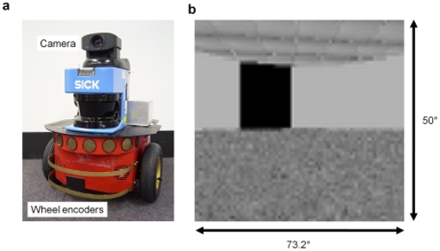

SmokeNav: Context (João Santos)
Smoke/Dust Presence
Trajectory/Pose
Ground Conditions
Individual Map
Sensor Behavior
Visual Information
Environment Features
<number>
CHOPIN R&D project

Slide 19
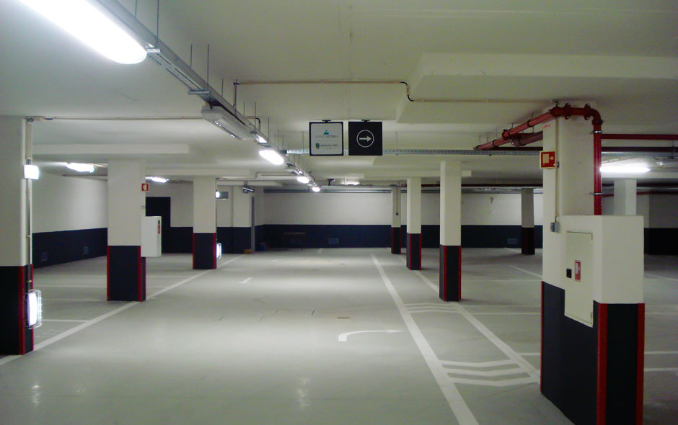
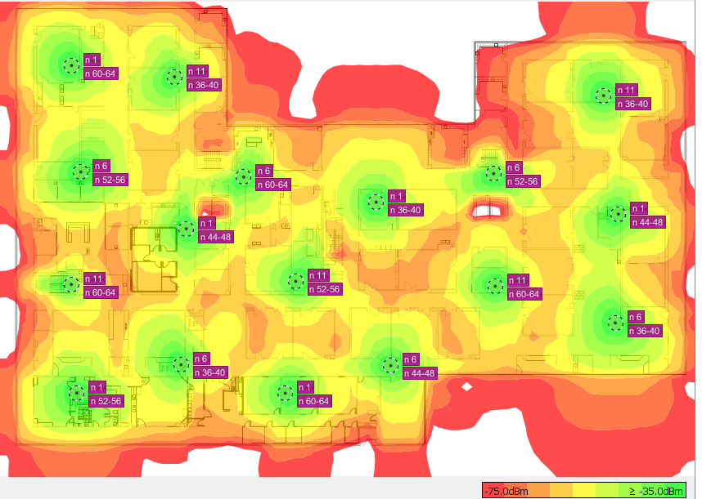
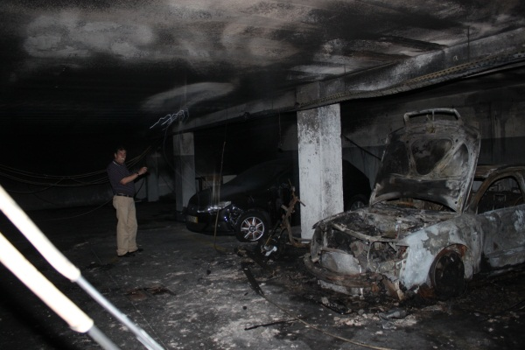
MRSLAM: Context (João Martins) 1/3
Floor/environment’s condition
Received signal strength indicator (RSSI)
<number>
CHOPIN R&D project

Slide 20
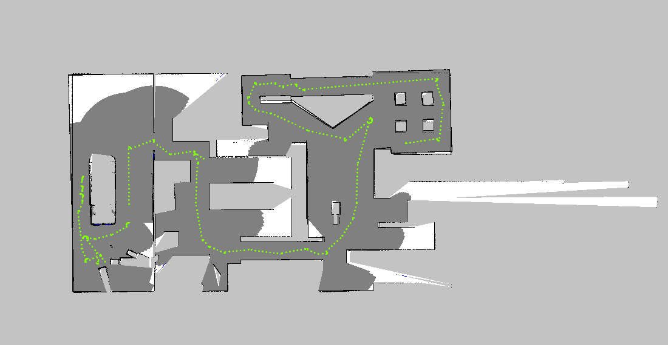
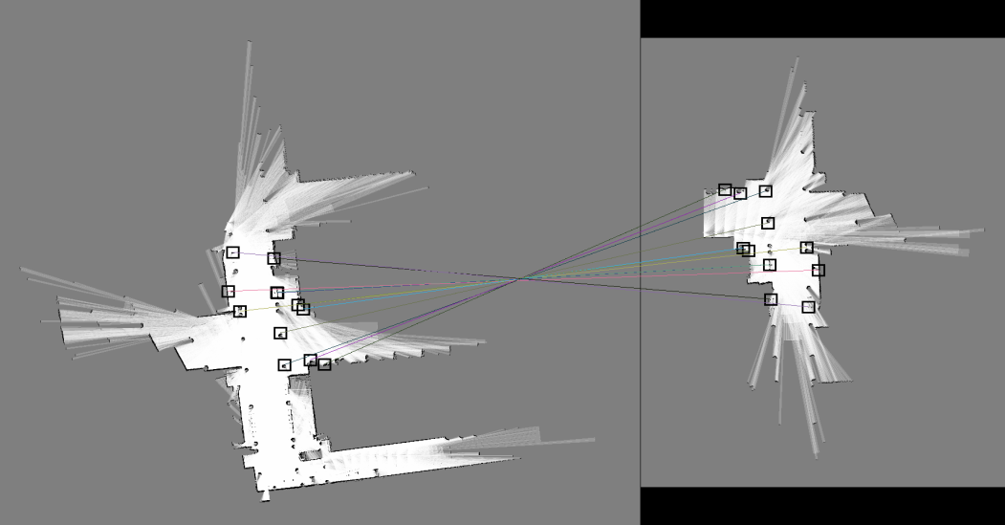
MRSLAM: Context (João Martins) 2/3
3. Navigation
(covered area)
4. Landmarks
<number>
CHOPIN R&D project

Slide 21
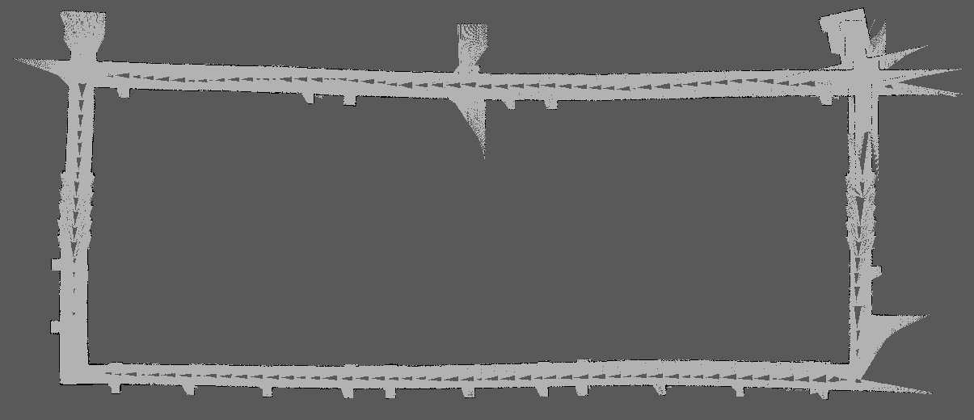
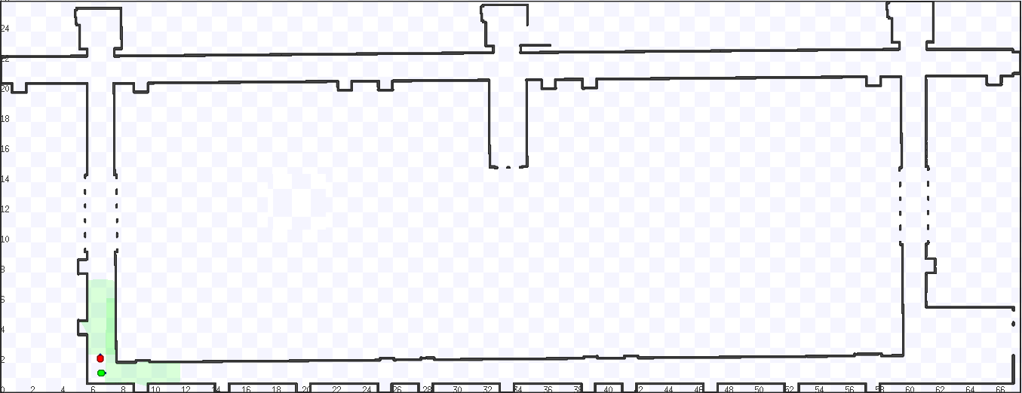
MRSLAM: Output (João Martins) 3/3
Global Map
Pose of all robots
<number>
CHOPIN R&D project

Slide 22
MRsensing: Context (Nuno Ferreira) 1/2
Contextual Information
Agent
related
Environment related
Classification Classes
Robot
Sensores
Classe A:
Air Contamination
Classe D:
Secure Ambient
Classe B:
Smoke
Classe C:
Fire
Classification
<number>
CHOPIN R&D project

Slide 23
MRsensing: Context (Nuno Ferreira) 2/2
Behavior/task: Acquire information to assess context
Guaranties to achieve the task: Acquire new information and share the same.
Influences :
Network status can influence the information sharing, if the network is overloaded with fundamental information for the fireman teams, extra information like temperature around the robots are unnecessary.
Sensors Features
Catastrophic conditions takes sensors to the limits, some sensors can be reliable in extreme conditions, like high/low temperatures.
Sensors need time to get ready to work.
<number>
CHOPIN R&D project

Slide 24
iBombeiro: Context (Andrea Pinto)
Agent
What influences the agent
to do what it is asked for?
Bombeiro
Smoke
Fire
Victims
Air contamination
Network
ARICA
Orders from CCO
Handheld device
Sensors
Classification
<number>
CHOPIN R&D project

Slide 25
CCO: Context (Eduardo Martins)
Firefighters and robots location (prevent agents moving towards hazardous conditions and allow na alternative safe egress if needed)
Building characteristics (construction materials, egress locations and eventual hazardous materials existence and location)
Heat characteristics (temperature variations, pyrolisis, crazing windows glazing, condensation in window, bubbling paint)
Smoke characteristics and airtrack variations (neutral level, color physical density and location, direction, velocity and flow)
Flame location and development state (Location, size and color, flashes recognition and rollover events)
Victims location.
<number>
CHOPIN R&D project

